Slide 1
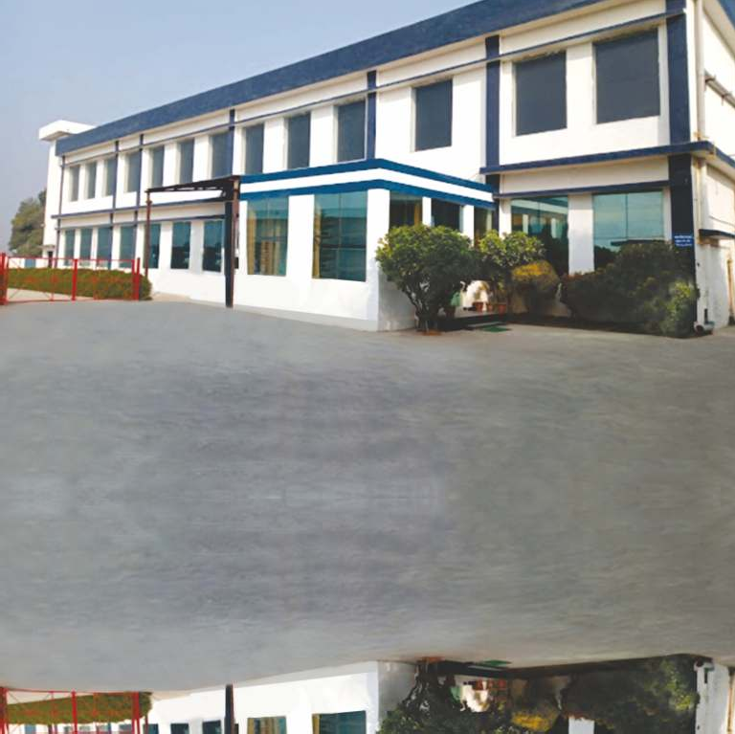

_{U B}UTTARANCHAL
BIOTECH LTD.

Slide 2
Message from Director
Dear Valuable Customers,
At UTTARANCHAL BIOTECH LTD., we pride ourselves on helping every member of your family lead productive, healthy and high quality lives. We constantly strive to offer a unique range of products - from prescription pharmaceutical to over-the-counter treatments. Corporate Social Responsibility is very much part of UBL’s fabric - we invest in people and environment through sponsorship and donations as well as compassionate care for those in need.
To best serve our clients we believe in establishing a range of international strategic partnerships to strengthen all activities from development and commercialization, product supply and marketing. We work continuously to consolidate a position as leading generic pharmaceutical company worldwide and as your trusted healthcare partner, providing you best in class products available.
Our knowledge, abilities, capability to innovate, productivity and our integrity enable us to be responsive to you and your family needs. We want to be your first choice.
We have proved successful in shortening of the development and commercialization process along with swift marketing authorizations to introduce new products to our markets supported by a harmonized production and distribution capability.
We welcome to you contact us - whether to enquire about our products or to offer your thoughts as to how we can best serve you.
Ashok Jain ( Director)

Slide 3
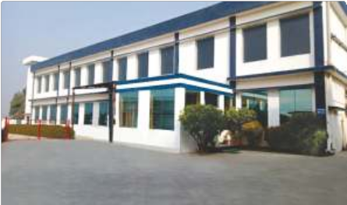
UBL AT A GLANCE
One of the fastest growing organization engaged in the manufacture & export of a wide range of pharmaceutical formulations for more than a decade
Manufacturer & exporter of a wide range of formulations – Oral formulations (Tablets, Capsules) /Liquid Orals / Ointments / Creams & SVPs
Equipped with World Class Machines
WHO approved manufacturing plant, maintaining stringent quality and following yardsticks of cGMP, integrating new technologies Catering globally to Asia, Africa and Latin American Markets with presence in over 25 countries .
Emerged as the most suitable partner and provider of Contract Research and Manufacturing Services (CRAMS) to our customers globally.

Slide 4

CORE COMMITMENTS
VISION
To improve the quality of life by making available products of highest quality at affordable prices
To ensure that quality becomes a habit, a commitment that finds expression at every stage from production, testing, marketing to employee relations
To be well-known globally, present in all continents of the world & trusted by healthcare professionals & patients across geographies
MISSION
To continue to be quality driven, research based, focused pharmaceutical company
To adapt and assimilate cGMP (current Good Manufacturing Practices) with strict adherence to environment safety
To build on the trust generated by the medical fraternity
To share management goals with employees and celebrate corporate successes with them

Slide 5


MANUFACTURING INFRASTRUCTURE (FDFs)
WHO GMP APPROVED FACILITY RECOGNIZED GLOBALLY & APPROVED BY VARIOUS STRINGENT REGULATORY AUTHORITIES & MOH’S
State of the art World class Fully Automated ultra Modern plant located at Rudrapur
WHO-GMP
Equipped with World Class Machines Capable of Manufacturing Wide Range of Formulations
LIQUID ORALS SOLID ORALS
SMALL VOLUME PARENTERALS
TOPICAL PREPARATIONS STERILE
NON STERILE

Slide 6





GLOBAL ACCREDITATIONS
WHO GMP APPROVED FACILITY RECOGNIZED GLOBALLY AND APPROVAED BY VARIOUS STRINGENT REGULATORY AUTHORITIES & MOH’S
KENYA PPB
YEMEN MOH
CAMBODIA FDA
NEPAL DDA

Slide 7
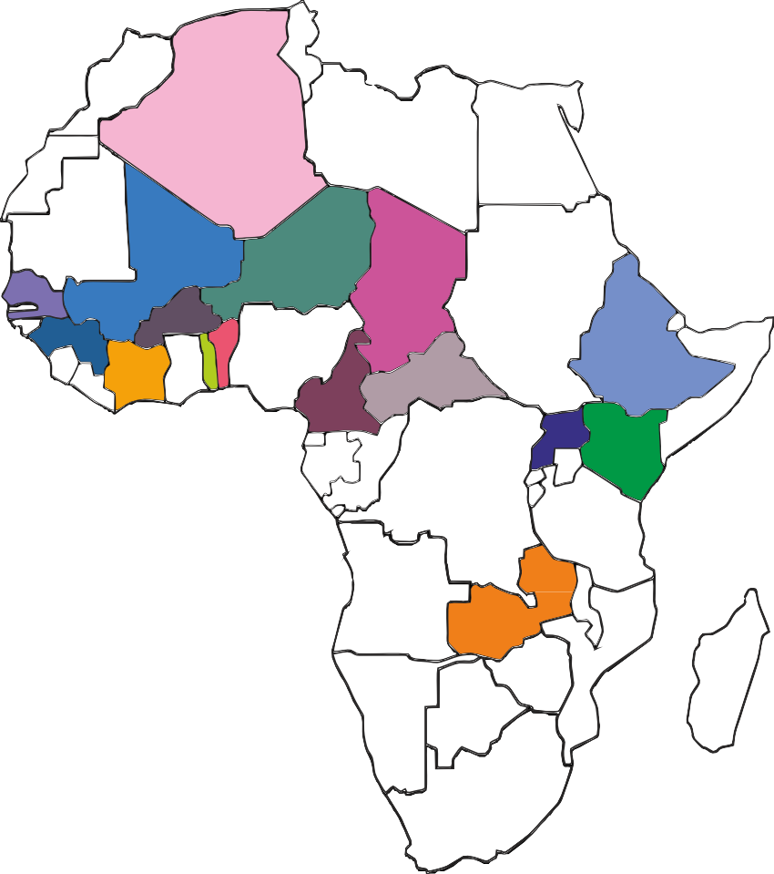
GLOBAL PRESENCE
PRESENT IN MORE THAN 25 COUNTRIES GLOBALLY & EXPANDING FURTHER WITH NEW FILINGS & REGISTRATIONS UNDERWAY
COTE D’VIORE
SENEGAL
MALI
NIGER
BENIN
GUINEA CONAKRY
CAMEROON
CAMBODIA
BURKINA FASO
TOGO
TCHAD
KENYA
UGANDA
ZAMBIA
NEPAL
MALI
NIGER
CHAD
SENEGAL
BURKINA FASO
BISSAU _{GUINEA}
BENIN
ETHIOPIA
IVORY COAST
TOGO
CAMEROON
UGANDA
KENYA
ZAMBIA

Slide 8
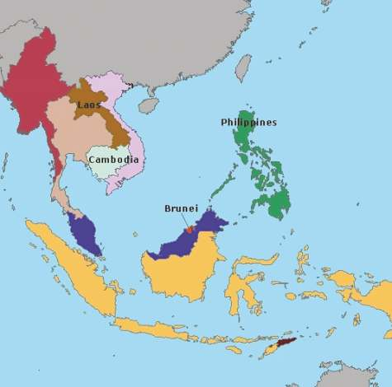
UBL PRESENCE IN SOUT EAST ASIA
PRESENT IN MORE THAN 5 COUNTRIES IN SOUTH EAST ASIA & EXPANDING FURTHER WITH NEW FILINGS & REGISTRATIONS UNDERWAY
CAMBODIA
PHILIPPINES
LAOS
MYANMAR

Slide 9
KEY THERAPUETIC AREAS
ANTI INFECTIVES, NSAIDs, CARDIOLOGY, ANAESTHETICS. PSYCHIATRIC & GASTRO ORAL SOLIDS
Sr. No. | Generic Name of the Product | Unit Pack | THERAPEUTIC GROUP
1 | Aceclofenac Sustained Released Capsules 200mg | 30C | NSAID
2 | Acelofenac 100mg & Paracetamol Tablets 325mg | 30T | NSAID
3 | Aceclofenac 100mg, Paracetamol 325mg and | 30T | NSAID
 | Serratiopeptidase Tablets 15mg
4 | Amiodarone Tablets IP 100mg | 100T | ANTI-ARRHYTHMICS
5 | Amlodipine and Atenolol Tablets 5mg+50mg | 30T | ANTI-HYPERTENSIVE
6 | Atorvastatin Tablets 20mg | 30T | LIPID LOWERING AGENT
7 | Azithromycin Capsules USP 250mg | 6C | ANTI-BACTERIAL
8 | Azithromycin Tablets USP 500mg | 3T | ANTI-BACTERIAL
9 | Ciprofloxacin Tablets BP 500 mg / 750mg | 20T / 10T | ANTI-BACTERIAL
10 | Clarithromycin Tablet USP 500mg | 10T | ANTI-BACTERIAL
11 | Diclofenac 50mg & Paracetamol 325 mg Tablets | 30T | NSAID
12 | Diclofenac Potassium Tablets USP 50mg / 75mg | 20T | NSAID
13 | Dicyclomine 20mg + Paracetamol 325 mg Tablets | 30T | ANTI SPASMODIC
14 | Doxylamine Succinate 10mg + Pyridoxine HCl 10mg + | 30T | ANTI-NAUSEANT
 | Folic Acid 2.5mg Tablets
15 | Duloxetine Hydrochloride Tablets 30mg | 30T | ANTI-DEPRESSANTS
16 | Escitalopram Tablets USP 10mg | 30T | ANTI-DEPRESSANTS
17 | Flunarazine Di Hcl 10mg + Domperidone 10mg Tablets | 30T | ANTI-MIGRAINE
18 | Flunarazine Dihydrochloride Tablets 10mg | 30T | ANTI-HISTAMINE
19 | Fluphenazine 0.5mg + Nortriptyline Tablets 10mg | 30T | ANTI-PSYCHOTIC
20 | Labetalol Tablets IP 100mg | 100T | ANTI-HYPERTENSIVE

Slide 10
KEY THERAPUETIC AREAS
ORAL SOLIDS
Sr. No. | Generic Name of the Product | Unit Pack | THERAPEUTIC GROUP
21 | Lamotrigine Tablets USP 50mg | 30T | ANTI-CONVULSANT
22 | Levetiracetam Tablets IP 250mg | 30T | ANTI-CONVULSANTS
23 | Levetiracetam Tablets USP 500mg | 30T | ANTI-CONVULSANTS
24 | Meloxicam Tablets BP 15mg | 30T | NSAID
25 | Metoprolol Tartrate Tablet BP 25mg/tab | 30T | BETA BLOCKER
26 | Metronidazole Tablets BP 500mg | 30T | ANTI-BACTERIAL
27 | Montelukast sodium 10mg + | 30T | ANTI-HISTAMINE
 | Levocetirizine Di HCl 5mg Tablets
28 | Mycophenolate Mofetil Tablets IP 500mg | 10T | IMMUNO SUPPRESSANT
29 | Mycophenolate Sodium Tablets 360mg | 10T | IMMUNO SUPPRESSANT
30 | Nimesulide Tablets 100mg/tablet | 30T | NSAID
31 | Nitazoxanide Tablets 500mg | 10T | ANTI-PROTOZOAL
32 | Norfloxacin Tablets USP 400 mg | 30T | ANTI-BACTERIAL
33 | Omeprazole Delayed Released Capsules USP 20mg | 30C | ANTI-ULCERANT
34 | Paroxetine Tablets BP 20mg | 30T | ANTI-DEPRESSANTS
35 | Pyridostigmine Bromide Tablets IP 60mg | 10T | ACETYLCHOLINESTERASE
 |  |  | INHIBITORS
36 | Rabeprazole 20mg+Domperidone 30mg SR Caps | 30C | ANTI - ULCERANT
37 | Risperidone Tablets 2mg | 30T | ANTI-PSYCHOTIC
38 | Rosuvastatin Tablets USP 10mg / 20mg | 30T | LIPID LOWERING AGENT
39 | Serratiopeptidase Tablets 10mg | 30T | NSAID
40 | Sertraline Tablets BP 100 mg / 50 mg | 30T | ANTI-DEPRESSANTS

Slide 11
KEY THERAPUETIC AREAS
INJECTABLES
Sr. No. | Generic Name of the Product | Unit Pack | THERAPEUTIC GROUP
1 | Bupivacaine HCl Injection IP | 5ML | ANESTHETIC
2 | Potassium Chloride for Injection-Concentrate USP. | 10ML | ANTI-HYPOKALEMIA
3 | Sodium Bicarbonate Injection USP | 10ML | ALKALINIZING AGENTS
SYRUPS
Sr. No. | Generic Name of the Product | Unit Pack | THERAPEUTIC GROUP
1 | Cetirizine Dihydrochloride, Ambroxol Hydrochloride & | 60ML, 100ML | ANTI-HISTAMINE
 | Dextromethorphan Hydrobromide Syrup
2 | Cyproheptadine HCl Oral solution USP 2mg/5ml | 100ML | ANTI-HISTAMINE
3 | Dextromethorphan 5mg, CPM 1mg & | 100ML | COUGH
 | Phenylephrine 2.5mg/5ml syrup |  | SUPPRESSANT
4 | Diphenhydramine Hydrochloride, Ammonium Chloride | 100ML | EXPECTORANTS
 | Sodium Citrate and Menthol Cough Syrup
5 | Dried Aluminium Hydroxide, Magnesium Hydroxide & | 170ML | ANTI-INFLAMMATORY
 | Oxetacaine suspension
6 | Lactulose Solution USP 10mg | 100ML | ANTI-LAXATIVE
7 | Montelukast and Levocetirizine Dihydrochloride Oral Syrup | 60ML | ANTI-HISTAMINE
8 | Nitazoxanide Oral Suspension 100mg/5ml | 60ML | ANTI-PROTOZOAL
9 | Paediatric Paracetamol Oral Solution BP 120mg/5ml | 100ML | ANALGESICS &
 |  |  | ANTIPYRETICS
10 | Paracetamol, CPM, Phenylephrine and Sodium Citrate syrup | 60ML | NSAID
11 | Paracetamol, Dextromethorphan Hydrobromide, | 100ML | ANALGESICS AND
 | Chlorpheniramine Maleate & Phenylephrine |  | ANTIPYRETICS
 | Hydrochloride Suspension
12 | Sodium Valproate Oral Solution BP | 100ML | ANTI-CONVULSANT

Slide 12
KEY THERAPUETIC AREAS
CREAMS, GELS & OINTMENTS
Sr. No. | Generic Name of the Product | Unit Pack | THERAPEUTIC GROUP
1 | Clobetasol Propionate,Neomycin & Miconazole Cream | 30GM | ANTI-INFECTIVE
2 | Clotrimazole,Beclomethasone Cream | 30GM | ANTI-FUNGAL
3 | Diclofenac Diethylamine, Virgin Linseed Oil, | 30GM | NSAID
 | Methyl Salicylate & Menthol Gel
4 | Diclofenac Gel BP | 30GM | NSAID
5 | Glucosamine Hydrochloride,Diacerein, | 30GM | CORTICOSTEROIDS
 | Capsaicin, Camphor and Menthol Ointment
6 | Hydroquinone, Tretinoin & Mometasone Furoate | 30GM | SKIN LIGHTENING
 | Cream |  | AGENTS
7 | Lanolin USP (Modified) | 30GM | EMOLLIENT
8 | Lidocaine and Prilocaine Cream USP | 5GM, 30GM | ANESTHETIC
9 | Lidocaine Hydrochloride Oral Topical Solution USP | 100ML | ANESTHETIC
10 | Lidocaine Ointment USP | 20GM & 30GM | ANESTHETIC
11 | Lignocaine Hydrochloride Gel IP | 5GM, 20GM, | ANESTHETIC
 |  | 30GM, 50GM
12 | Nifedipine 0.3% and Lignocaine 1.5% Cream | 30GM | ANESTHETIC
13 | Silver Sulfadiazine Cream USP 1% w/w | 50GM | ANTI-BACTERIAL

Slide 13


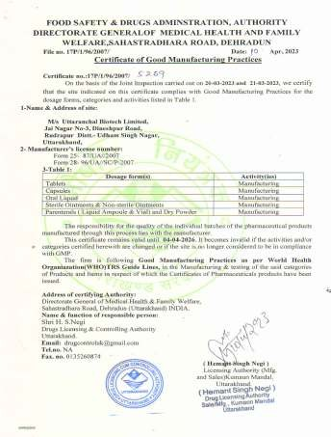
Our Plant Adheres to WHO GMP Standards

Slide 14


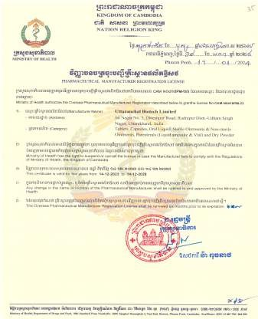
Our Plant Adheres to WHO GMP Standards

Slide 15

With one foot firmly entrenched in the fast
growing in the vast International Market, UBL is beautifully poised to achieve greater heights…..

Slide 16




UBL/200/07-2024
_{UB} UTTARANCHAL
BIOTECH LTD.
Office: 30-A, Government Industrial Estate, Charkop, Kandivali (West), Mumbai - 400 067, INDIA. Tel. No. : +91 22 6263 9000
Plant: Jai Nagar-3, Dineshpur Road, Rudrapur - 263 153 (U.S. Nagar), Uttarakhand, INDIA.
E-mail: info@ublgroup.in Website: www.ublgroup.in

