Slide 1
ASSOCIATED BIOTECH
Things Get Better With Quality.
www.associatedbiotech.com

Slide 2
MISSION, VISION & VALUES
Our Mission is to be the significantly progressive contributor in making this world a healthier place to live by exploring resources available, and making our products available in the remotest part of the world, in competitive and fair price range & maintain highest standard of international quality in manufacturing and distribution. Create wealth for all our Stakeholders, Customers, Investors, Associates, Vendors & Society.
Our Vision is to be among the world’s most trusted brands in Pharmaceuticals Industry and positively impacting the health of one billion lives across the globe by 2030.
Our Values that we believe to have a positive impact on the lives of millions of people every single day. We strive to not only make medicine but making a meaningful difference to the lives of those we serve, through utmost Integrity, Honesty, Trust, Team Work, Commitment to customers and Humility.

Slide 3
OVERVIEW
Established in 2006 with a vision to serve humanity with quality products. Since medicines directly have an impact on the health and lives of patients, Associated Biotech strives for quality control.
From more than 16 years in the Pharmaceutical Industry, Associated Biotech has grown tremendously to manufacture and supply high quality affordable pharmaceutical medicines. Clinical testing of our manufactured products ensures safe and effective end products.
Associated Biotech manufacturer the qualitative Tablets, Capsules and Dry Syrups apart from this our company has expanded to herbal and cosmetics segments. Our packaging team is very particular about the quality standards of packed pharmaceutical products. Packaging at Associated Biotech is finished with a contemporary yet classy look, designs are creative and done by our in house professional with the right aluminum and PVC foils.

Slide 4
PRODUCTS MANUFACTURED
Domestic & Export
1. Cephalosporin's
2. General ProductS
The facility currently targets to specialize in
1.Tablets
2.Capsules
3.Dry syrup
4.Ready to use taste masks compressed Granules.
We Also Deal in
1.Nutraceuticals
2.Ayurveda
3.Cosmetics

Slide 5
BUSINESS STRATEGY
Excellent quality Products
World class packaging
Total customer satisfaction
Wide product Range
On Time Delivery

Slide 6
INTERNATIONAL PRESENCE
Without resting on its laurels of demonstrating unmatched quality in manufacturing drugs for the domestic market, Associated Biotech has persistently sought to enter new, emerging as well as developed markets throughout the world. Further raising the quality bar & meeting the stringent standards as required by foreign drug regulatory bodies has enabled forays into multiple countries spread across Central – West & North Africa, South East Asian Countries.
Our goal of helping humankind live well is not confined to just our domestic market and therefore we are continuously working on expanding the reach of the company so that our life-saving drugs can reach as many people as possible and at competitive prices. Deeper penetration into highly regulated markets such as MENA and CIS Countries, Latin America remains our key goals. The distinguished quality assurance system put in place by Associated Biotech will allow for the same in the near future.

Slide 7
FDA & QUALITY APPROVALS
WHO-GMP
ISO 9001:2015 (AGSI CERTIFICATION)
GMP KENYA (PHARMACY AND POISONS BOARD)
NATIONAL AGENCY FOR FOOD AND DRUG ADMINISTRATION CONTROL (NIGERIA)
MINISTRY OF HEALTH (CAMBODIA)
NATIONAL FOOD AND DRUG AUTHORITY (UGANDA)
DPLM (IVORY COAST)

Slide 9
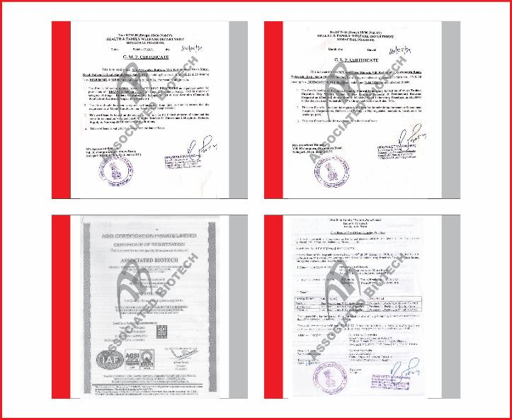
PLANT CERTIFICATIONS

Slide 10
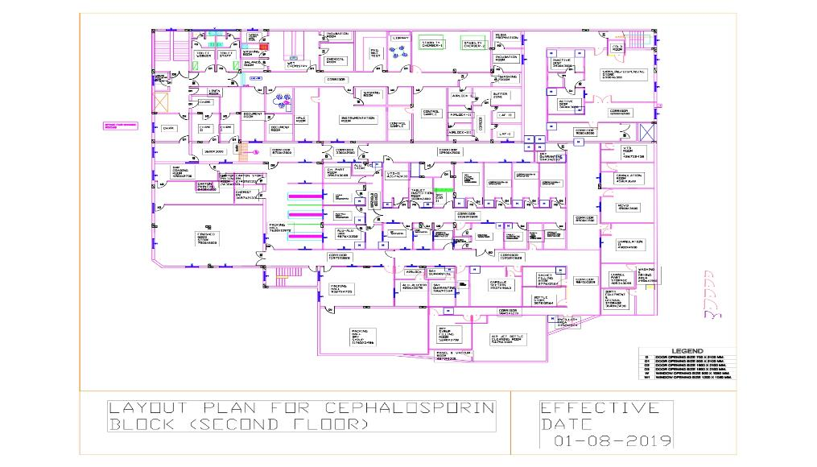
PLANT LAYOUT CEPHALASPORIN BLOCK

Slide 11
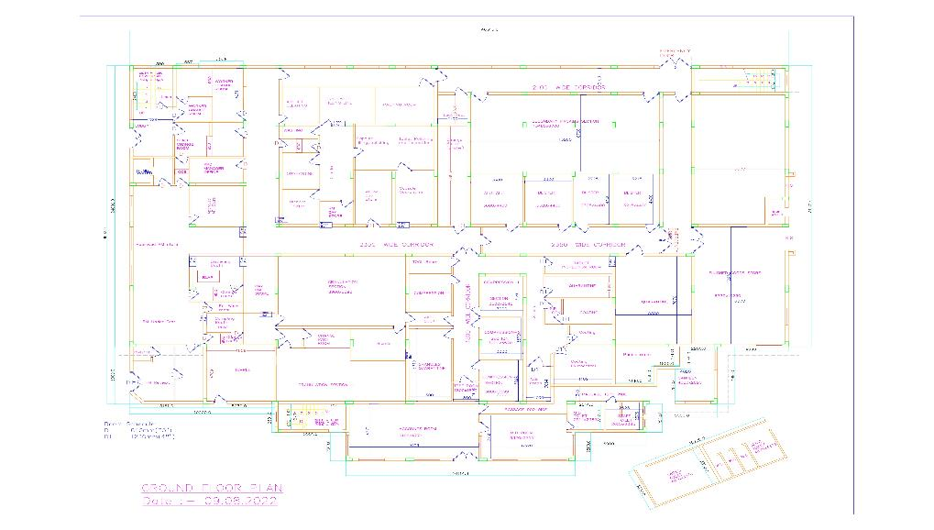
PLANT LAYOUT GENERAL BLOCK

Slide 12
MANUFACTURING CAPACITY (PER MONTH)
Cephalosporin Block
Tablet
1.5 Cr.
Capsule
1.25 Cr.
General Block
Tablet
2.5 Cr.
Capsule
1.0 Cr.
Dry Syrup
25 Lac
Dry Syrup
10 Lac

Slide 13
PLANT AREA
Total land Area Cephalosporin Block
2710 Sq. Mt.
Total constructed Area Cephalosporin Block
2800 Sq. Mt.
Total land Area Non Beta Block
2710 Sq. Mt.
Total land Area Total constructed Area Cephalosporin Block
1400 Sq. Mt.

Slide 14
OUR EMPLOYEES OUR STRENGTH
PRODUCTION
STAFF (11)
WAREHOUSE
STAFF (11)
QUALITY ASSURANCE
STAFF (12)
WORKERS (67)
WORKERS (24)
WORKERS (2)
QUALITY CONTROL
STAFF (32)
ENGINEERING
STAFF (10)
HUMAN RESOURCES
STAFF (10)
WORKERS (7)
WORKERS (30)
WORKERS (20)
MARKETING
STAFF (50)
PURCHASE
STAFF (15)
ACCOUNTS
STAFF (10)

Slide 15
ORGANOGRAM
Managing Director
Mr. Sanjeev Goel
Head
QA
Head
QC
Head
Warehouse
Head
Production
Head
HR
Head
Engineering
Head
Administration
Officer executive QA
Officer/
Executive QC
Officer/ Executive Warehouse
Officer/ Executive
Production
Tablet
Officer/ Executive
Production
Capsule
Officer/
Executive
Production
Dry Syrup
Electrician/
Mechanic/ Executive
Assistant/ Officer/ Executive

Slide 16
KEY PERSONNEL OF PLANT
NAME | DESIGNATION | QUALIFICATION | EXPERIENCE
Mr. Umakant Mishra | Head-Production | B.Sc., B. Pharm | 18 Years
Mr. Sandeep Saraswat | Head-QC | M.Sc. | 20 Years
Mr. Anil Kumar Verma | Manager-Production | B. Pharm | 15 Years
Mr. Santosh Kumar | Head-QA | B.Pharm | 12 Years
Mr. Pradeep Thakur | Head-HR | M.Com, PGTM | 15 Years
Mr. Santosh Kumar | Executive-HR | B. Com | 12 Years
Mr. Ashok Kumar Singh | Head-Warehouse | B.Sc., MBA | 20 Years
Mr. Nirmal Singh | Head-Engineering | Diploma in electrical | 16 Years

Slide 17
SECURITY
Plant has 24 hours Security Staff for Internal and External Security.

Slide 18
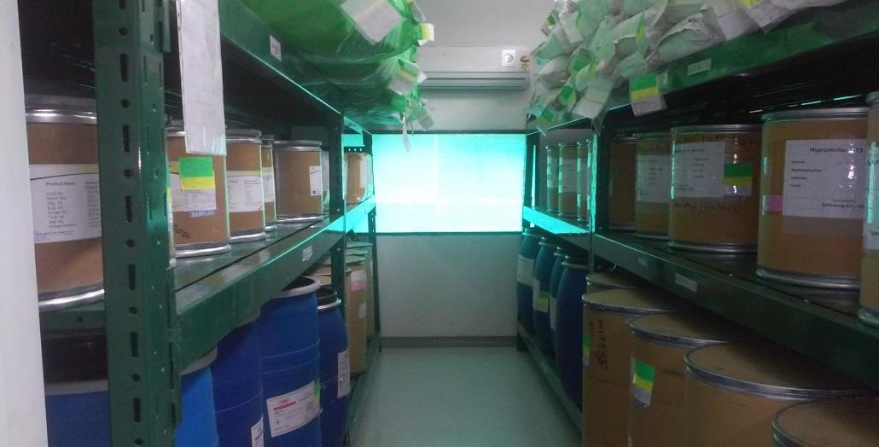
CEPHALOSPORIN BLOCK FACILITY
(A View of Raw Material Warehouse)

Slide 19
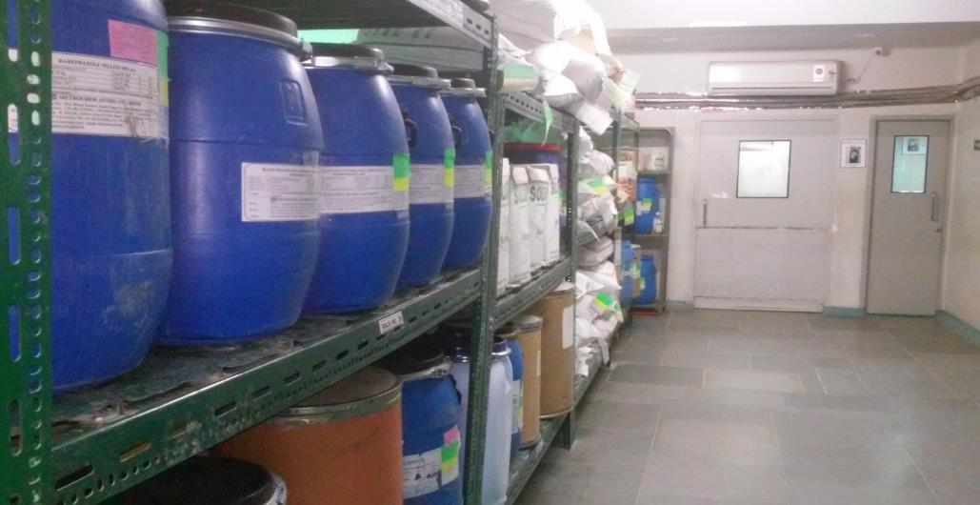
GENERAL BLOCK FACILITY
(A View of Raw Material Warehouse)

Slide 20
GENERAL BLOCK FACILITY
MAJOR PLANT MACHINERY
MACHINE | MAKE
Sampling & Dispensing Booth | Pranay Ind.
Rapid Mixer Granualator | Sainath Boilers
Octagonal Blender | Grover International
Fluidized Bed Dryer | Altek
Multi Mill | Growers Instruments
Paste Kettle | Amulya Indstries
Neo Cota | Neo Machine
Alu-Alu Packing Machines | Elmach Packing
Balances | Samson
Compression Machines | CIP
Capsule Filling Machines | Pam Pharmaceuticals

Slide 21
CEPHALOSPORIN BLOCK FACILITY
MAJOR PLANT MACHINERY
MACHINE | MAKE
Vaccum Tray Dryer | Mevish Pharma
Roll Compactor | Chamunda Pharma
Octagonal Blender | Amulya
Vibro Shifter | Grovers
Compression Machines | Accura
Ganson Auto Coater | Gansons Limited
Alu-Alu 3010 | Elmach Packing
Tablet Inspection Machine | Paragon
Dry Syp Powder Filling & Sealing Machine | Parth Engg.
Induction Sealing Machine | Electronic Devices
Labrlling Machine | Global Packaging

Slide 22
MAJOR UTILITIES
CHILLING PLANT
CAPACITY (TR) | MAKE | QUANTITY
39 | Blue Star | 03
70 | Blue Star | 01
COOLING TOWER
CAPACITY (TR) | MAKE | QUANTITY
100 & 150 | Eneertech | 02
50 | Eneertech | 02
COMPRESSED AIR
CAPACITY (TR) | MAKE | QUANTITY
105 | Chicago Pneumatic | 01
197 | IR | 01

Slide 23
MAJOR UTILITIES
Bore Well
Multi Grade Sand Filter
Reverse Osmosis Purifier (RO-I)
Reverse Osmosis Purifier (RO-II)
Mix bed
UV Light
Purified Water Storage Tank
Distribution Loops
User Outlets
Components of Purified Water System

Slide 24
MAJOR UTILITIES
Bore well is use as a source of raw water. The raw water is stored in 2000 litres tank and treated with 2 ppm chlorine and 2 ppm DE chlorination (SMBS) dosing.
The treated water is stored in storage tank having capacity of 2000 litres. The treated water is used for RO water generation.
The treated water is passed through the sand filter, carbon filter, RO plant & mix bed.
The purified water is monitored continuously for its conductivity and pH.
This purified water is stored in a 1000 Ltr S.S. Storage tank after that its passes through 0.2 micron filter &UV lamp then it is distributed to manufacturing area by S.S pipe lines. The tank is regulary cleaned & record of cleaning is maintained.

Slide 25
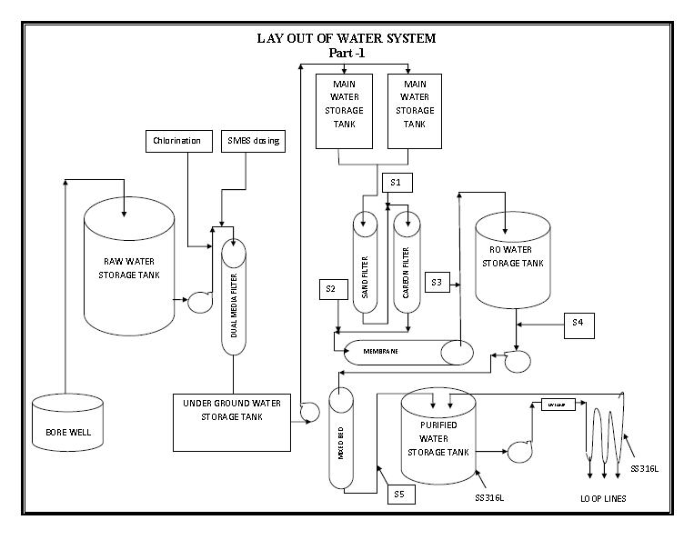
SCHEMATIC DIAGRAM OF PRE-TREATMENT OF PURIFIED WATER

Slide 26
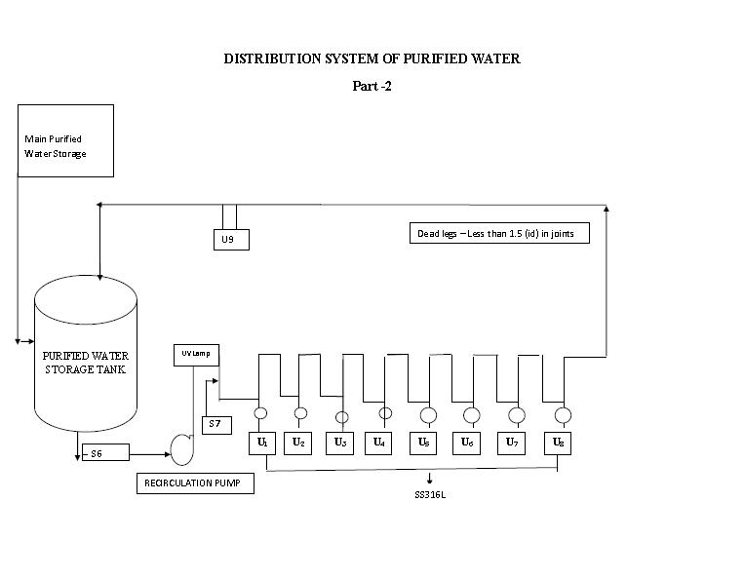
SCHEMATIC DIAGRAM OF PRE-TREATMENT OF PURIFIED WATER

Slide 27
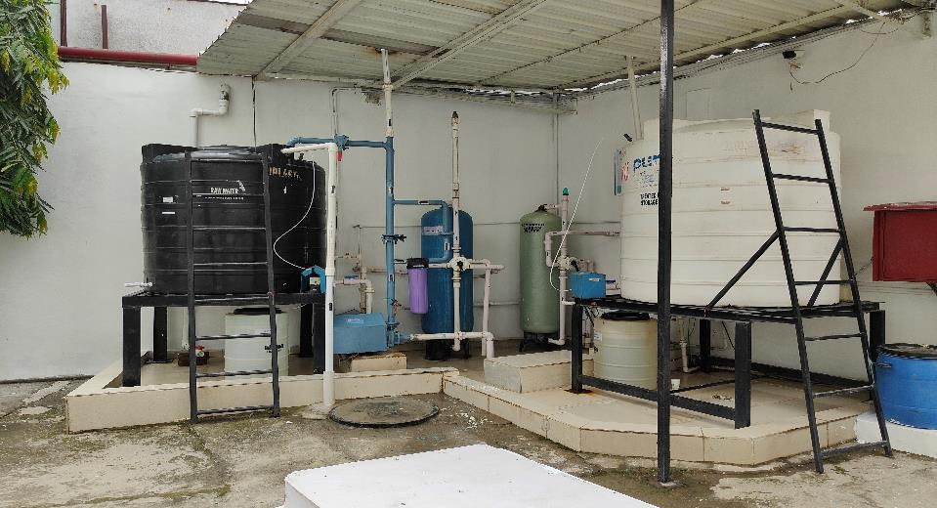
PRE - TREATMENT OF WATER SYSTEM
(A View of Pre-treatment of Water System)

Slide 28
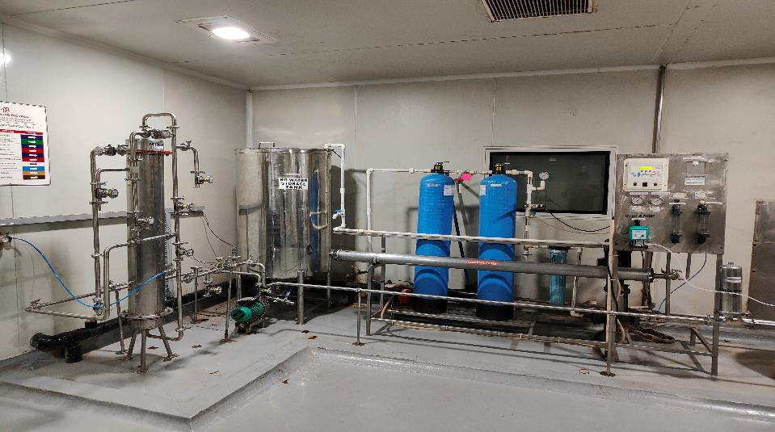
MAJOR UTILITIES
(A View of Purified Water System)

Slide 29
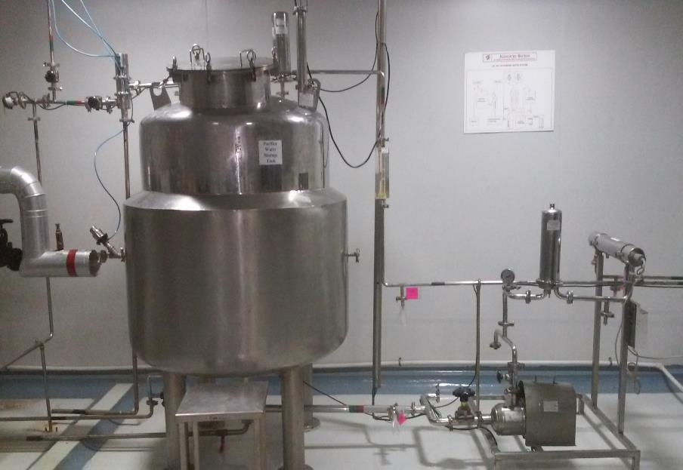

Slide 30
HVAC SYSTEM
(AHU & DHU DESCRIPTION)
BLOCK / AREA | QUANTITY (in No.)
CEPHALOSPORIN BLOCK DHU | 19
CEPHALOSPORIN BLOCK AHU | 17
GENERAL BLOCK AHU | 21
GENERAL BLOCK DHU | 05

Slide 31
HVAC SYSTEM
(DHU DESCRIPTION- CEPHALOSPORIN BLOCK)
Design Criteria : Manufacturing / Packing area
Specification of supply air : Class 100,000 (ISO 14644-1 Class 8)
Temperature : Controlled (22 ± 3 °C)
Humidity : Controlled (15 ± 5%)
Air change rate : Controlled, (NLT 20/Hr.)
Re-circulation (%) : About 10% fresh air in re-circulation type
Filter design and efficiency:
In classified area, 0.3µ filtered supply air provided. Terminal HEPA filters are installed suitably in product processing area as per applicability. The system consists of suitable pre-filtration prior to HEPA filtration.

Slide 32
HVAC SYSTEM
(AHU DESCRIPTION)
Design Criteria : Manufacturing / Packing area
Specification of supply air : Class 100,000 (ISO 14644-1 Class 8)
Temperature : Controlled (25 ± 3 °C)
Humidity : Controlled (50 ± 5%)
Air change rate : Controlled, (NLT 20/Hr.)
Re-circulation (%) : About 10% fresh air in re-circulation type
Filter design and efficiency:
In classified area, 0.3µ filtered supply air provided. Terminal HEPA filters are installed suitably in product processing area as per applicability. The system consists of suitable pre-filtration prior to HEPA filtration.

Slide 33
HVAC SYSTEM
(AHU DESCRIPTION)
In non-classified area, the supply air is filtered either of 10 & 5 micron as per suitable area requirements. Pre filters (supply, return, dust extractor) shall be cleaned periodically and are changed if required.
The out side agency carries out HEPA filter integrity testing.

Slide 34
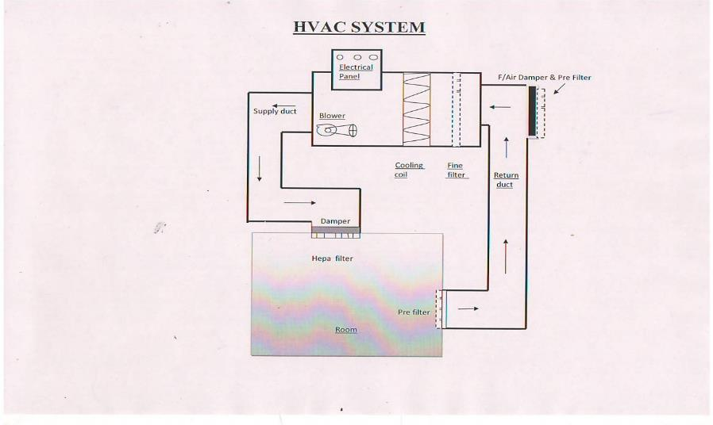
SCHEMATIC DIAGRAM OF AHU
10 μ
5 μ
0.3 μ
10 μ

Slide 35
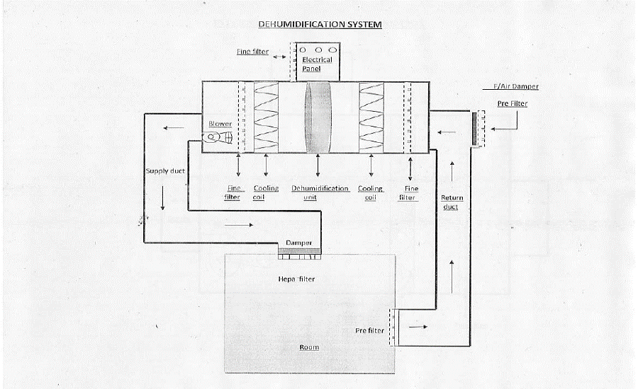
SCHEMATIC DIAGRAM OF DHU
10 μ
3 μ
5 μ
0.3 μ
10 μ

Slide 36
WASTE DISPOSAL
Effluent treatment plant (ETP)
ETP sludge – Handover to Shivalik solid waste management.

Slide 37
Quality Assurance &
Quality Control

Slide 38
QUALITY MANAGEMENT SYSTEM
Plant is equipped with Quality Management System which consist of Quality Assurance & Quality Control Department.
The Quality Assurance Department is independent from Manufacturing.

Slide 39
QUALITY MANAGEMENT SYSTEM
FUNCTIONS OF QUALITY ASSURANCE DEPARTMENT
Approval of raw material, finished product packaging material specification and test procedures.
Establish, implement and ensure appropriate cGMP standards and practices at all stages of Manufacturing and activity related to manufacturing.
Establish and Implement of basic Quality system and its related documents.
Process monitoring and performing IPQA during the processing and packing of products.
To investigate process deviation, analysis and implement corrective action taken.
Review and verification of microbiological monitoring records of processing water.

Slide 40
To ensure compliance of system against their standard operating procedures suggesting the necessary revision and updating as per cGMP and regulatory requirements.
QA Officer online inspects and reviews the batch manufacturing activities and documents for compliance of manufacturing operation as per BMR.
Ensure that the established norms are followed and laid down specifications met for the product manufactured.
To approve the qualification protocol and to monitor and review qualification activities.
To investigate customer complaint in co-ordination with production.
Performing product quality review.
Responsible for the control and distribution of all controlled documents.
Cross verification of daily monitoring records in the product processing area.
Sampling of finished products.

Slide 41
QUALITY MANAGEMENT SYSTEM
FUNCTIONS OF QUALITY CONTROL DEPARTMENT
Preparation and implementation of raw material, finished, packaging materials specifications and method of analysis.
Establish, verify and implement quality control procedures.
Sampling of raw material and packing material are as per the written procedures.
Testing and approving of raw materials, packaging materials, and in-process samples to the current specification.
Testing of finished products.
Validation of the test methods.

Slide 42
To carry out stability studies of the product.
Procurement of reference standards, preparation and maintaining of working standards.
Investigation of laboratory deviations and their documentation.
To check and carry out inspection and analysis of control samples.
Calibration / qualification of the laboratory equipment as per the frequency and ensure records are maintained.
Establish and carry out microbiological testing as per the written procedures and at predetermined frequency.

Slide 43
Implementation of Quality System.
Analysis of Raw, In process & Finished Sample.
To Approve or Reject all Components, Drug Product Containers, Closures, Raw materials In- Process Materials, Packaging Material, Labeling and Drug Products.
Participation in Validation Program.
Management of Reference Sample.
Maintenance & Calibration of Testing Instruments.
Laboratory Personnel Training.
Stability Testing.

Slide 44
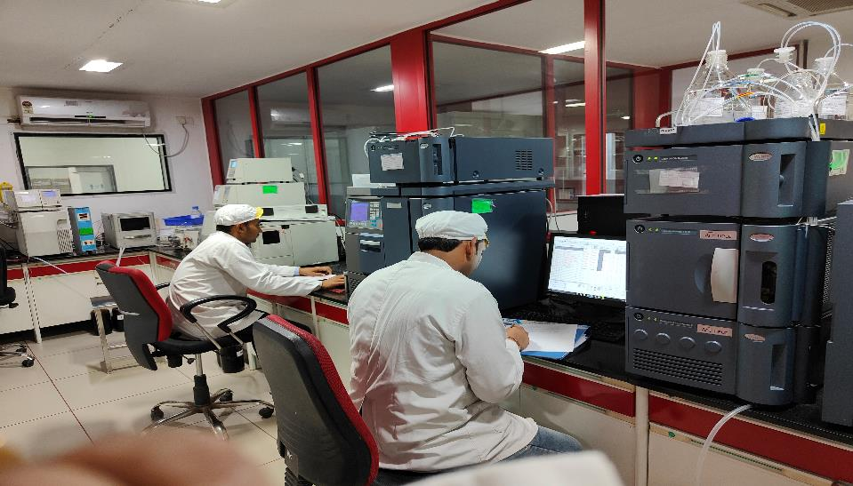
QUALITY CONTROL DEPARTMENT
(A VIEW OF HPLC LAB)

Slide 45
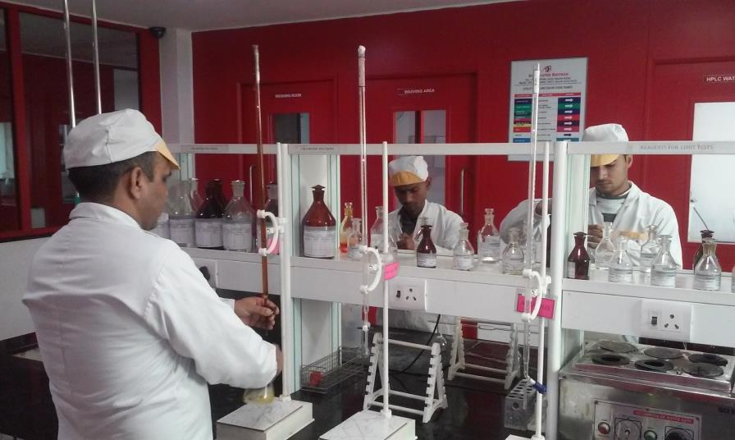
QUALITY CONTROL DEPARTMENT
A VIEW OF WET CHEMISTRY LAB

Slide 46
QUALITY CONTROL DEPARTMENT
(Stability Study Programme)
Plant is equipped with Stability Chambers to Carry out
Stability Studies as per ICH Q1 AR2 at various conditions like
Details:-
Accelerated Stability Studies at 40⁰C ± 2⁰C & 75% RH ± 5% RH
Real Time Stability Studies at 30⁰C ± 2⁰C & 75% RH ± 5% RH

Slide 47
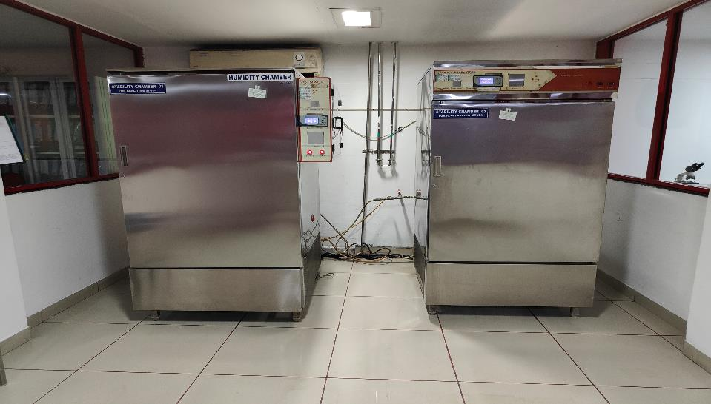
QUALITY CONTROL DEPARTMENT
A VIEW OF STABILITY CHAMBER

Slide 48
PRODUCTION MACHINERY
VACCUM TRAY DRYER (VTD) , ROTACONE VACCUM DRYER, AUTO COATER, ALU-ALU PACKING MACHINE , DRY SYRUP FILLING

Slide 49
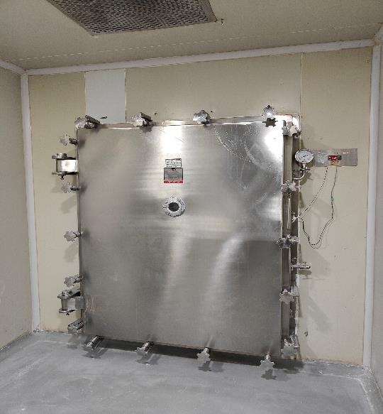
VACCUM TRAY DRYER (VTD)

Slide 50
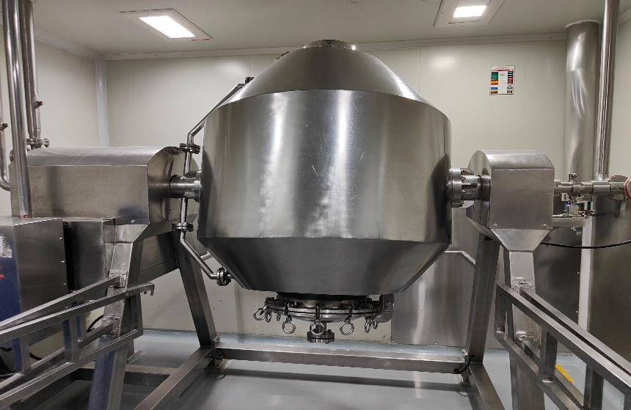
ROTA CONE VACCUM DRYER (RCVD)

Slide 51
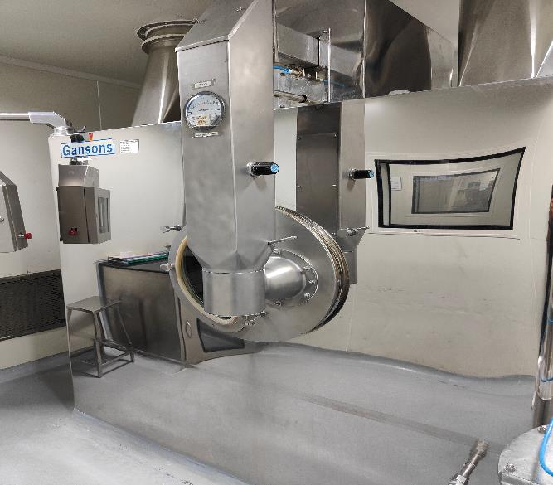
AUTO COATER

Slide 52
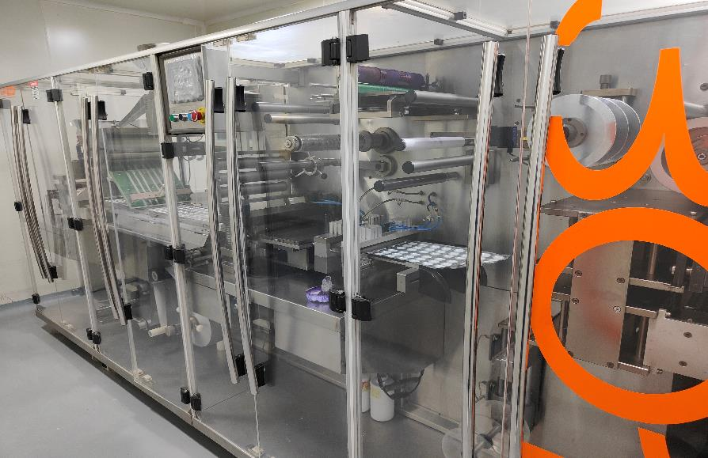
ALU-ALU PACKING MACHINE

Slide 53
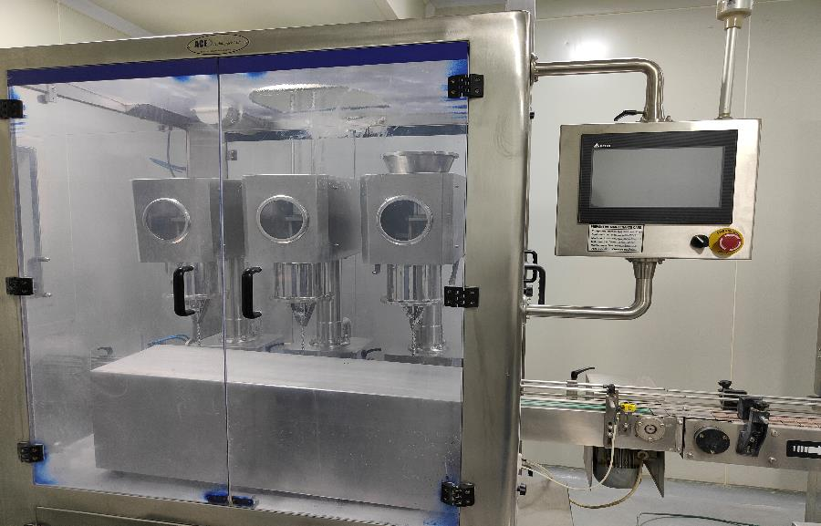
DRY SYRUP FILLING MACHINE

Slide 54
I sincerely appreciate that I’ve had this opportunity to present to you.
Thank you for giving your precious time and attention.

Slide 55
"Life's not just about staying alive...it's about being well!"
Thanks A Lot.

